Slide 1





Retail s Marketing Analytics Project For Customer Segmentation s Growth Strategy
A Comprehensive End to End Analytics Project for Students
Duration: 2-3 Hours | Recorded Lectures Available
@ashoks773 @ashoks773 @sharma-ak
Instructor: Dr. Ashok Kumar Sharma Bioinformatics Scientist (Senior Data Analyst) Cedars Sinai Medical Center, Los Angeles, CA
Personal webpage: https://ashoks773.github.io
Tools: Python | Pandas | Numpy | Scikit-learn | Scipy | Statsmodels | Matplotlib | Seaborn | Plotly
Follow: @datawithashok

Slide 2
Project Overview
This comprehensive analytics project demonstrates a complete data science workflow for retail and marketing analytics, from data acquisition to actionable insights and dashboard creation.
Objectives
Business Problem
A multi-channel retail company faces several challenges:
Customer Segmentation: Identify distinct customer groups using RFM analysis and K-Means clustering
Sales Analysis: Analyze sales trends, seasonality, and product performance
Marketing Optimization: Evaluate customer lifetime value and marketing efficiency
KPI Design: Create comprehensive metrics framework for business monitoring
Visualization: Build interactive dashboards for stakeholder communication
Declining customer retention rates (42% vs industry benchmark of 45-50%)
Limited understanding of customer behavior and preferences
Inefficient marketing spend without proper segmentation
Inconsistent sales performance across product categories and regions
Need for data-driven decision making
Business Questions
Who are our most valuable customers?
Target Roles
Marketing Analyst; Business Intelligence Analyst; Data
Analyst; Retail Analytics Specialist
What drives customer retention and churn?
How can we optimize our product mix?
Which marketing strategies deliver the best ROI?
What are the key performance indicators we should track?

Slide 3
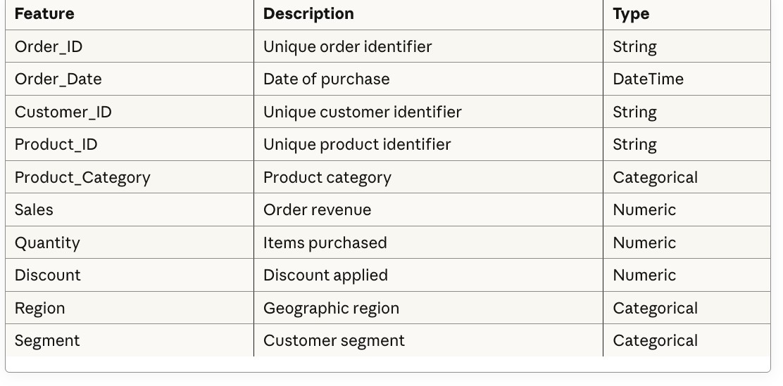
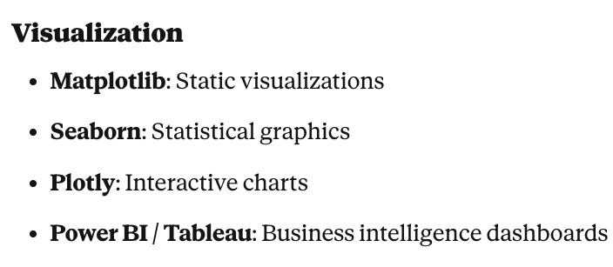
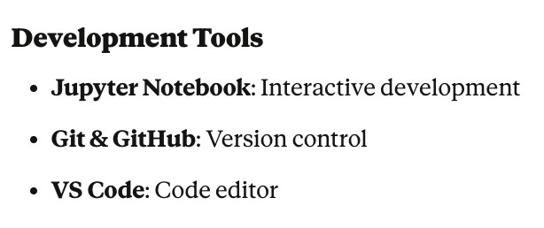
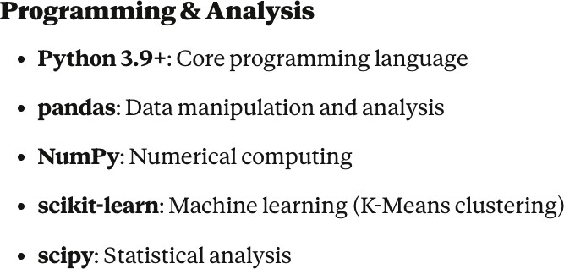
Project Overview
Dataset:
Key Features:
Primary: Kaggle - Retail Sales Dataset
Type: Transactional retail data
Size: ~10,000 transactions
Time Period: 2022-2024 (adjustable based on actual data)
Technologies Used:

Slide 4

Project Workflow
Phase 1: Data Preparation (Refer to Notebook)
Data acquisition from Kaggle
Initial data quality assessment
Missing value treatment
Outlier detection and handling
Feature engineering
Data type optimization
Phase 3: Advanced Analytics (Refer to Notebook)
RFM Analysis (Recency, Frequency, Monetary) K-Means Clustering (4 customer segments) Cluster profiling and naming
Market Basket Analysis (optional)
Cohort retention analysis
Customer Lifetime Value calculation
Phase 2: Exploratory Analysis (Refer to Notebook) Phase 4: KPI s Reporting (Refer to Notebook)
Univariate analysis (distributions)
Bivariate analysis (relationships)
Time series patterns
Customer behavior analysis
Product performance analysis
Correlation analysis
Comprehensive KPI framework
Monthly trend analysis
Category and regional performance
Executive summary report
Dashboard data preparation
Strategic recommendations
END-TO-END

Slide 5




Learning Outcomes
Technical Skills
Data acquisition and ETL processes
Data cleaning and preprocessing techniques Exploratory data analysis (EDA)
Statistical analysis and hypothesis testing Machine learning (K-Means clustering) Customer segmentation (RFM analysis) Data visualization best practices Dashboard design and creation
SQL and database concepts
Python programming for data analysis
Business Skills
Retail and marketing analytics KPI design and measurement
Customer lifetime value (CLV) calculation Market basket analysis
Cohort analysis and retention metrics
Business insight generation Executive communication
Strategic recommendation development
Tools s Technologies
Python (pandas, scikit-learn, matplotlib) Jupyter Notebooks
Power BI / Tableau Git C GitHub Kaggle API
LEARNING

Slide 6
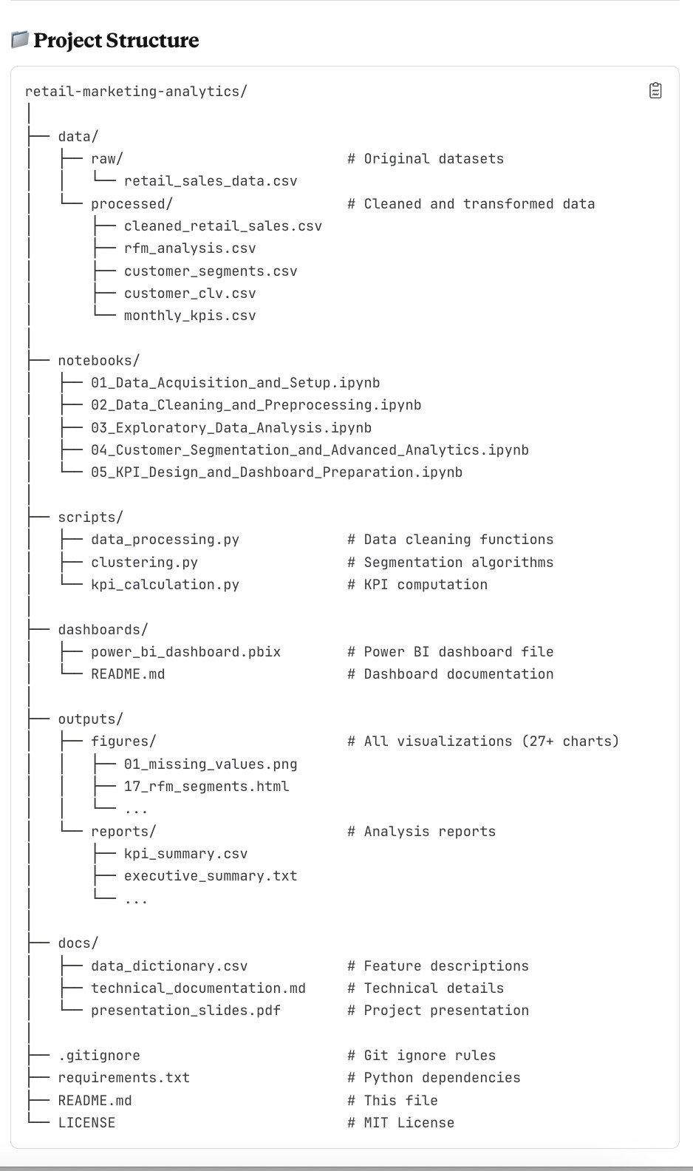
Create GitHub Repo for the Project
# Add all files git add .
# Create initial commit
git commit -m "Initial commit: Complete retail C marketing analytics project"
# Create GitHub repository (via GitHub website) # Then connect local to remote
git remote add origin https://github.com/yourusername/retail-marketing-analytics.git
# Push to GitHub git branch -M main
git push -u origin main

